Slide 1
The Last Lecture
CS 5010 Program Design Paradigms
"Bootcamp"
Lesson 12.1
© Mitchell Wand, 2012-2015
This work is licensed under a Creative Commons Attribution-NonCommercial 4.0 International License.

Slide 2
Let’s see where we’ve been
Data Representations
Design Strategies
Basics
Combine simpler functions
Generalization
Mixed Data
Use a template
Over Constants
Recursive Data
Divide into Cases
Over Expressions
Functional Data
Call a more general function
Over Contexts
Objects & Classes
Recur on subproblem
Over Data Representations
Stateful Objects
Communicate via State
Over Method Implementations

Slide 3
The Point
1. It’s not calculus. Getting the right answer is not enough.
2. The goal is to write beautiful programs.
3. A beautiful program is one that is readable, understandable, and modifiable by people.

Slide 4
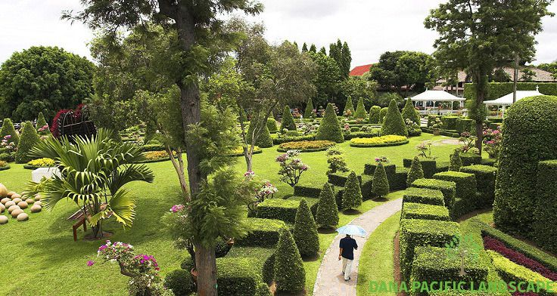
Your programs should look like this:
source

Slide 5
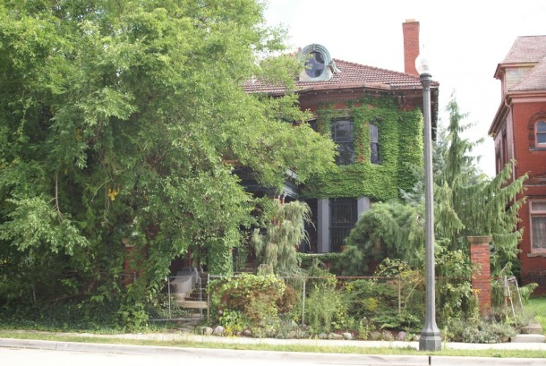
Not like this
source

Slide 6
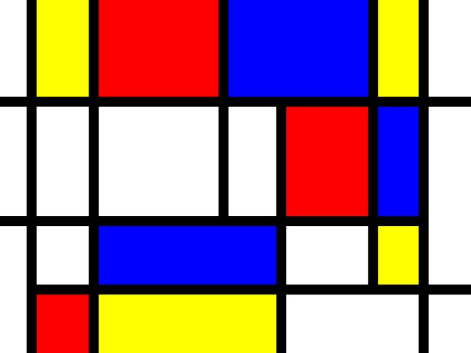
Your programs should look like this
source

Slide 7
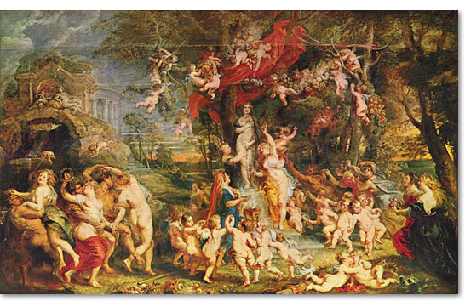
Not like this
source

Slide 8
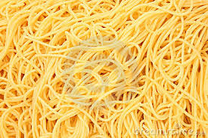
And never, ever like this
source

Slide 9
Key Practices for writing beautiful programs
1. Write programs that people can read, understand, and modify.
2. Represent information as data; interpret data as information.
3. Use contracts and purpose statements to specify the intended behavior of your functions and methods.
4. Use invariants to limit your functions’ responsibility.
5. Use functions and methods that produce and consume values.
6. Use state only to share information between distant parts of the program.
7. Use interfaces to limit dependencies between different parts of your program.

Slide 10
1. Write programs that people can read, understand, and modify
You write programs so others can read them
Bosses, customers, maintainers, etc.
This means an older version of you, too
You work with others as you develop programs
The earlier you articulate your thinking, the earlier you can catch flaws
The earlier you catch flaws, the easier/cheaper they are to fix

Slide 11
2. Represent Information as Data; Interpret Data as Information
representation
Information
Data
interpretation
The distinction between information and data is one of the key concepts of this course. Any time we have some data, we have to give its interpretation: that is, what the data means.

Slide 12
3. Use contracts and purpose statements to specify the intended behavior of your functions and methods
The person who calls your function should never have to read your implementation to figure out what your function returns.

Slide 13
Good function names and purpose statements help the reader
Imagine the reader is looking at some code that calls your function.
The reader should be able to make a good guess about your function produces just from its name.
If he/she needs more information, he can read your contract, purpose statement, invariants, etc.
If your purpose statement is good, the reader should never have to look at your function definition.
The only thing that matters is the value your function returns, not how it finds that value.

Slide 14
Design Strategies give the reader a clue about the “how”
Design Strategies
1. Combine simpler functions
2. Use template for <data def> on <value>
3. Divide into cases on <condition>
4. Use HOF <mapfn> on <value>
5. Call a more general function
6. General Recursion
7. Update state
If you were tweeting out a description of how your function works, what would you say?
If you can’t summarize it in a tweet, your function is too complicated!
Notes:
Here is the function design recipe.

Slide 15
4. Use Invariants to Limit Your Function's Responsibility
Your function may need to rely on information that is not under its control and not represented in its contract.
Record this assumption as an invariant (WHERE clause).

Slide 16
Invariants document the assumptions that each function or method makes about its arguments
If your contract is f: Something -> ??, then your function has to give the right answer for every possible Something.
If you have a WHERE clause, the function is only responsible for giving the right answer for inputs that satisfy the invariant.
f’s caller is responsible for making sure that the invariant is satisfied.

Slide 17
5. Use functions and methods that produce and consume values
Functional model makes it easy to create examples and test data
Easier to understand
Easier to test

Slide 18
Design one function/method per task
Small is good. Period.
Big is bad. Period.
If you have complicated junk in your function, you must have put it there for a reason. Turn it into a separate function so you can test it.
Find a good name for your help function (after-tick-helper doesn’t qualify!) If you can’t think of a good name for your help function, then you are probably doing it wrong.

Slide 19
Design functions systematically
Structure of data tells you the structure of the program
Or at least gives you good hints!
The organization of your data definitions leads you to the organization of your program.

Slide 20
The Structure of the Program Follows the Structure of the Data
World
world-after-tick
Rectangle
Throbber
rect-after-tick
throbber-after-tick
or
x-pos
y-pos
unselected-rect-after-tick
selected-rect-after-tick
rect-x-pos-after-tick
x-vel
y-vel
rect-y-pos-after-tick
rect-x-vel-after-tick
A Portion of the Data Tree
rect-y-vel-after-tick
Maybe this won’t work out in every detail, but it gives you a plan!
A Portion of the Program Tree
(your wishtree)

Slide 21
6. Use state only to share information between distant parts of the program.
You need to use state in exactly two situations:
you need an object with stable identity to send messages to (like the wall in our first example)
you need to construct cyclic structures (like the factory and the world)
Sometimes you need state, but less often than you might think
Java, C++, etc. lead you to use state more often than you should.
State complicates everything!

Slide 22
7. Use interfaces to limit dependencies between different parts of your program.
Always manipulate your data through a set of functions.
That way, if you change the representation of your data, you won’t have to change other parts of your program
We didn’t emphasize this much in the course, but it did come up:
The Guided Practice about the crazy pizza-maker
Graphs over abstract data
Interfaces in OO

Slide 23
Other important things...

Slide 24
The Function Design Recipe
The Function Design Recipe
1. Data Design
2. Contract and Purpose Statement
3. Examples and Tests
4. Design Strategy
5. Function Definition
6. Program Review
Here is the Function Design Recipe, which has been the heart of this course. We hope that you will follow it whenever you have a programming task. It can apply to non-programming tasks, too.
Notes:
Here is the function design recipe.

Slide 25
Don't Repeat Yourself
Introduce a generalization whenever you start to duplicate code.
Any time you copy & paste, look for a pattern.
One is an exception; two is a coincidence; three is a pattern.
But don't generalize until you know what the pattern is.
It's OK to copy & paste for a while until you see the pattern. But be sure to replace them all with good generalizations. Your testers and maintainers will thank you.

Slide 26
Don't Reinvent the Wheel
Use other people’s code, libraries, etc. whenever possible (and legal).
You aren’t (or shouldn’t be) paid by the line!

Slide 27
Design Systems Iteratively
Most real problems are too complex to model at once.
Pick important pieces of information, design data, write functions, & repeat.
Most real problems require too much functionality
Pick important functions, design, repeat.
New functionality may require new data designs.
But can reuse purpose statements, (some) tests, contracts.

Slide 28
Summary: You need never be afraid of this:
You need never be afraid of a blank page.

Slide 29
You know the questions to ask
What is the relevant information from the world?
How should it be represented as data?
What is the purpose of this system/function/method?
How should I go from purpose to code?

Slide 30
And you know how to write down the answers
Data Definitions and Interpretations
Contracts and Purpose Statements
Examples and Tests
Design Strategies
Code

Slide 31
Go get ‘em!!
And good luck!
Stay in touch.
--Prof. Wand

